Slide 1
ENSE 470 Milestone 2
Group Eh?
Nickolas Schmidt, Quinn Bast Abdulaziz Alghamdi
January 25th 2017

Slide 2
Previous Kaizen Bursts
Multiple Forms of submissions causing wasted time and confusion
Software users don’t know the appropriate approvers
Multiple versions of the faxed submission forms which lack information
No confirmation if initial request is valid
Approver names held in two files and managed by two different groups

Slide 3
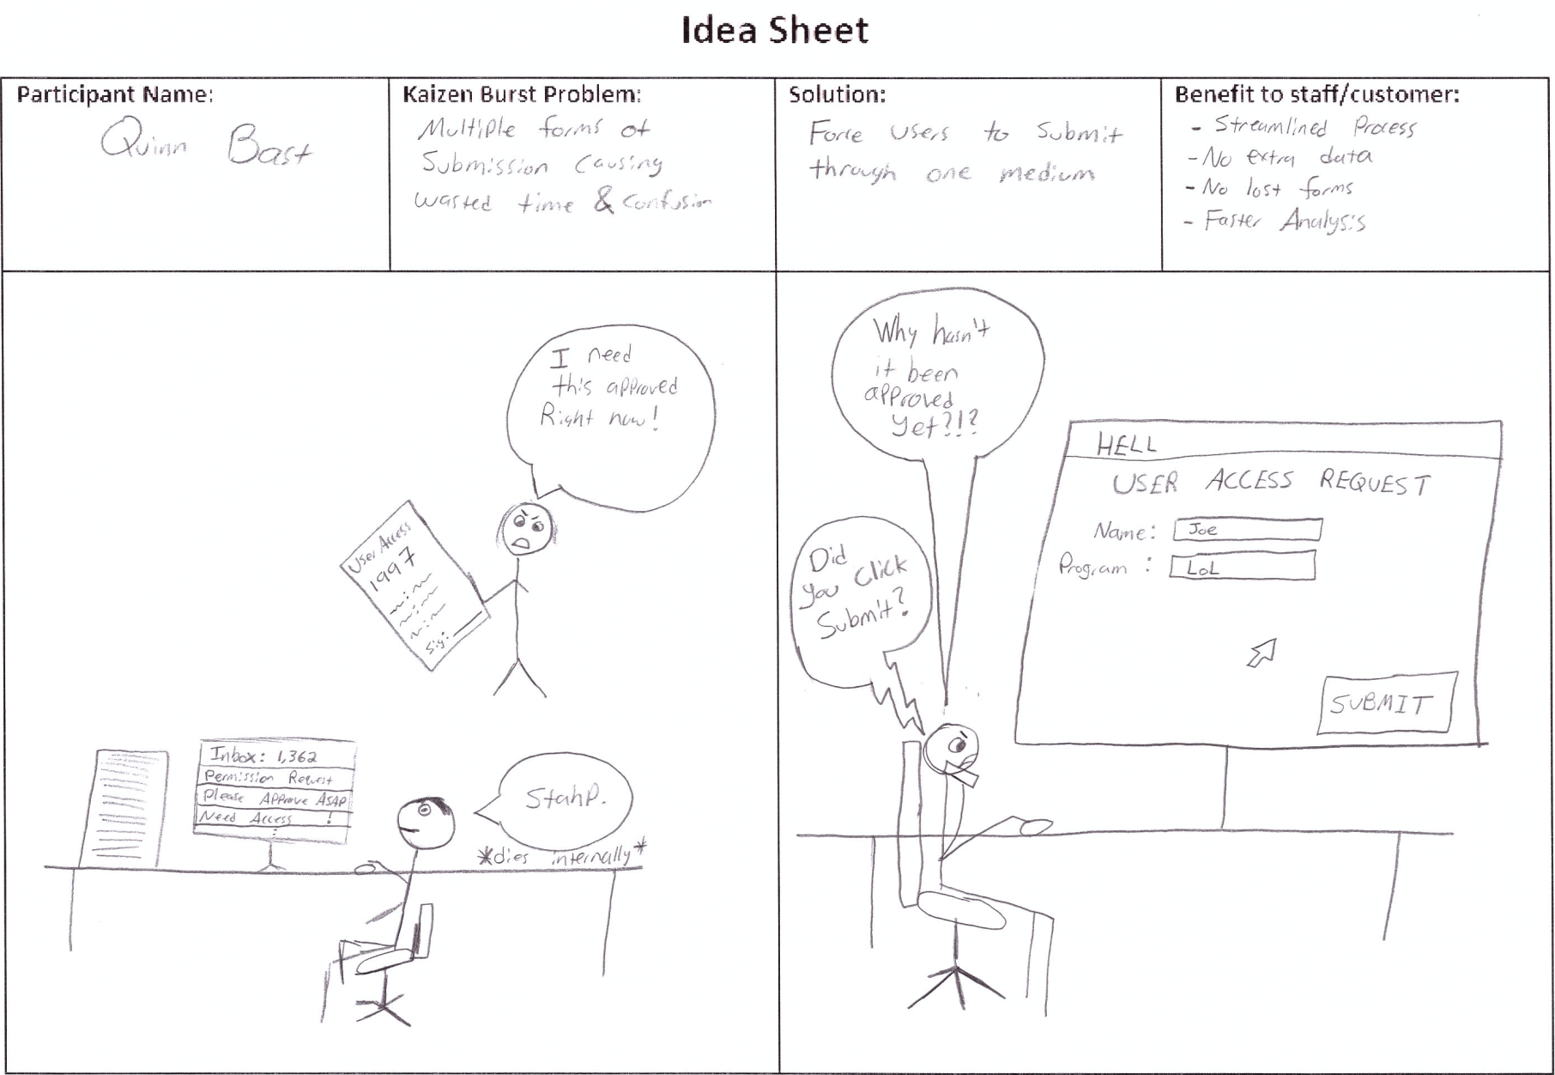
Idea Sheets

Slide 5
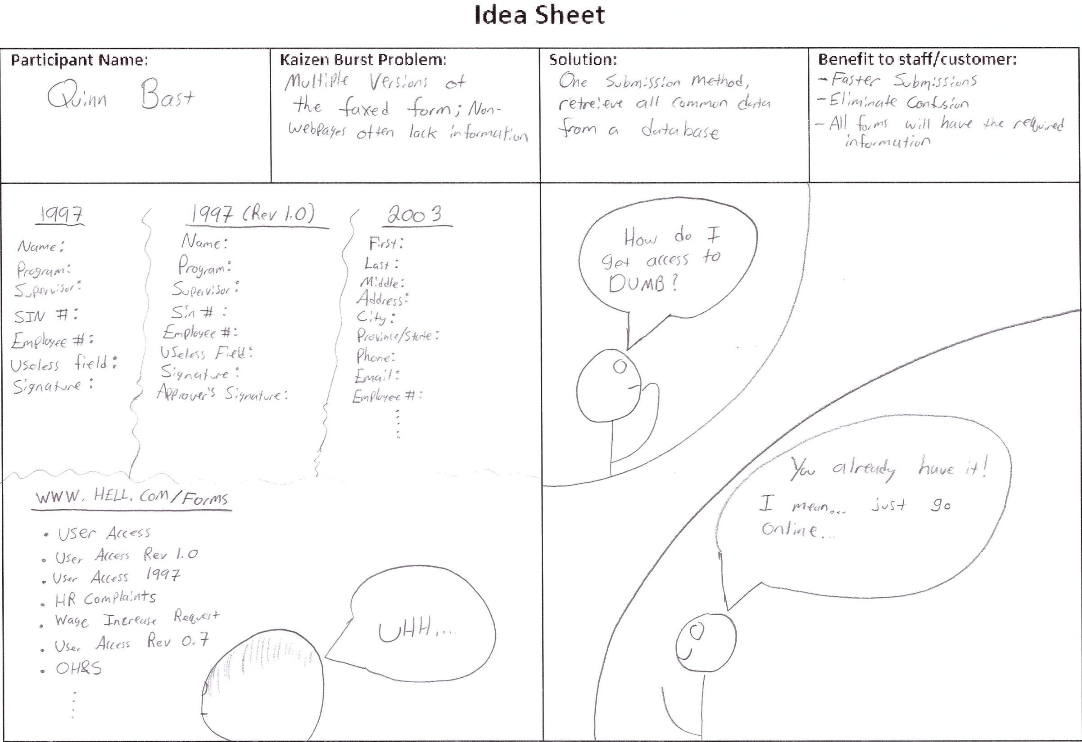

Slide 6
Idea Sheets

Slide 7
Idea Sheets

Slide 8
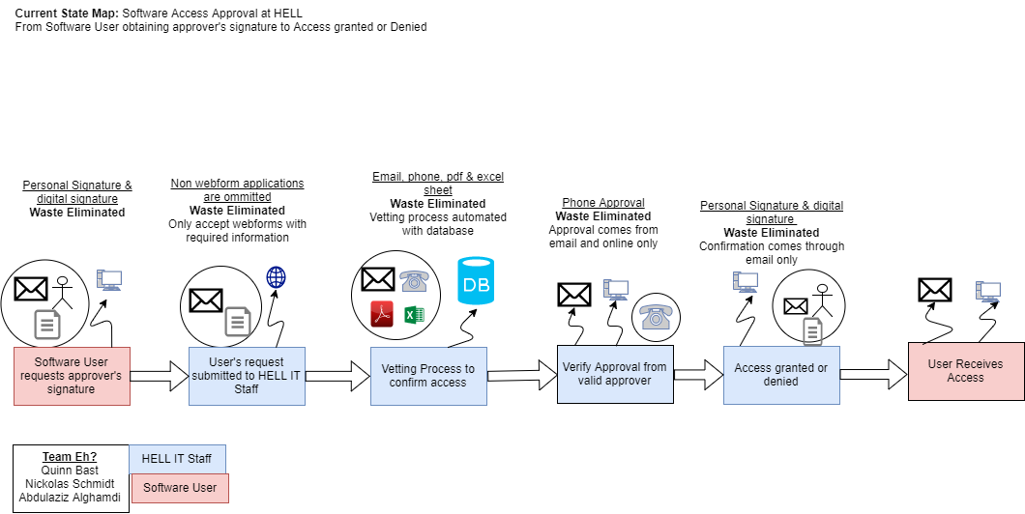
Future State Value Stream Map (VSM)

Slide 9
Group Reflection
How did you feel about this milestone? What did you like/dislike?
Good continuation to the first milestone to provide insight as to how to improve the system.
What did you learn about yourself as you collaborated and worked through this milestone?
Furhter developed relationships with the team members and learnt draw.io is an extremely useful tool as you can re-upload exported files to edit again. Learnt we all suck at drawing.
How will you use what you have learned going forward?
Future state value streams eliminate waste from a system, allowing for a more streamlined approach. This is valuable to improve a current system’s flow.
What "Stuff & Things" related to this milestone would you want help with?
Drawing and Artistic skills.

